Slide 1

2023
AIR QUALITY INDEX
PREDICTION
WITH MACHINE LEARNING MODEL

Slide 2
QUESTION STATEMENT
01
Air quality for a human being and all the living species is a vital part of life. Variation of
air quality creates a high impact on human life; continuous monitoring and evaluation and investigation of AIR quality are critical. Based on that, we are supposed to take and
action and control all the activities in every sense. To achieve this purpose

Slide 3
01
INTERSHIP PROJECT ARCHITECTURE
VISUALIZATION
AND
FEATURE ENGEENERING
EDA AND OUTLIER
REMOVAL
DEPLOYMENT
AND WITH USER
INTEFERENCE
MODEL BUILDING
AND EVALUATE
ACCURACY
Click here to add you to the center of the narrative thought
Click here to add you to the center of the narrative thought

Slide 4
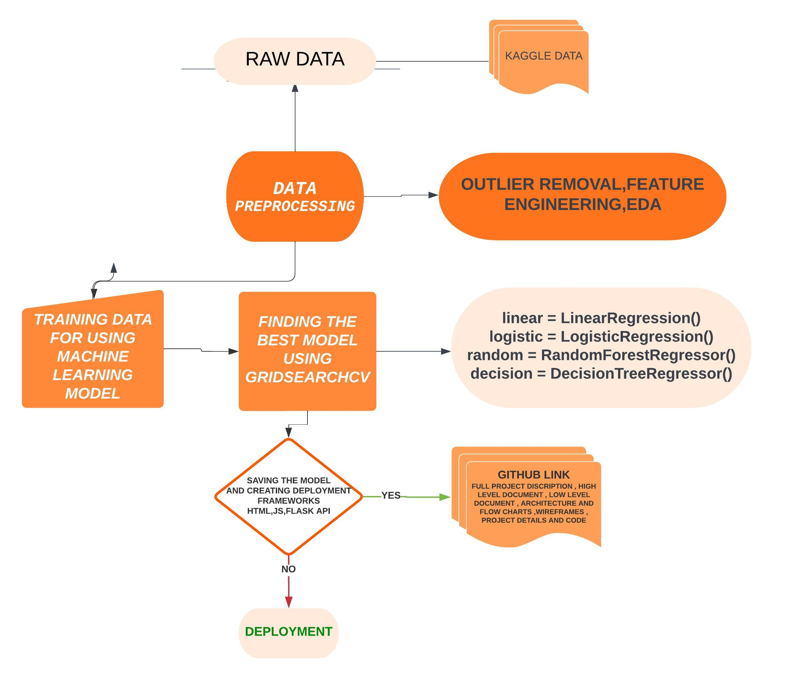

Slide 5
2
PROJECT SUMMARY
Prediction is based on the weather forecast. This study uses various time series forecasting techniques to predict
India's Air Quality Index (AQI) for the following periods. The pollutants level for Sulphur Dioxide (SO2),
Carbon Monoxide (CO2), Nitrogen Dioxide (NO2), and Particulate Matter (PM2.5, PM10), among others, have been
forecasted for different locations in India. Various evaluation metrics are applied to evaluate the model.
WE ARE CHAMPION
this paper also includes references from multiple sources that throw some light on air pollution's underlying issues.
As a result, this may be utilized for numerous future relevant research and discussions regarding India's air pollution.
For the implementation work, different machine learning methods were used. Some regression techniques like Linear Regression
LR), Decision Tree Regressor (DTR), Random Forrest (RF), and some classification techniques like Logistic Regression (LR),
Decision Tree (DT), Random Forrest (RF) have been applied to achieve a better result. Regression models were applied to
predict the AQI score, and classification models were built to classify the model based on the AQI score.
The performance measurements Mean Squared Error (MSE), Root Mean Squared Error (RMSE), Mean Absolute Error (MAE),
and Kappa Score are used to calculate error rates. Regression and Classification two models are merged for our prediction.
TEMPLATE
Ip = [IHi – ILo / BPHi – BPLo] (Cp – BPLo) + ILo
Ip = index of pollutant p Cp = truncated concentration of pollutant p
BPHi = concentration breakpoint i.e. greater than or equal to Cp BPLo = concentration breakpoint i.e. less than or equal to Cp
IHi = AQI value corresponding to BPHi ILo = AQI value corresponding to BPLo

Slide 6
How to calculate Air Quality Index?
The formula to calculate AQI is the same as per the Indian CPCB and US-EPA. The AQI is calculated using the equations separately for parameters. For example, if you wish to calculate AQI on the basis of four parameters, use the equation four times, and the worst sub-index communicates the AQI. A subindex is a linear function (two different yet related notions) of the concentration of pollutants.
1. Indian equation for AQI:
The Indian AQI range differs from that of US-EPA. To calculate AQI, a minimum of three parameters should be taken out of which one must be either PM10 or PM2.5.
To calculate sub-indices, 16 hours of data is needed.
For example: If you wish to calculate AQI on the basis of PM2.5, CO, and ozone, calculate the sub-index for each parameter separately.
If the current concentration of PM2.5 is 110 ug/m3, then referring to AQI range as per Indian standards BPHi = 120, BPLo = 91, IHi = 300 and ILo = 201.
Putting the values in equation and solving:
Sub Index= [(300-201)/ (120-91)] (110-91) + 201 = 265.86
Similarly, for other parameters, the sub-index can be calculated and the worst sub-index shows the AQI.

Slide 7
FORMULA
Ip = [IHi – ILo / BPHi – BPLo] (Cp – BPLo) + ILo
Ip = index of pollutant p
Cp = truncated concentration of pollutant p
BPHi = concentration breakpoint i.e. greater than or equal to Cp
BPLo = concentration breakpoint i.e. less than or equal to Cp
IHi = AQI value corresponding to BPHi
ILo = AQI value corresponding to BPLo

Slide 8
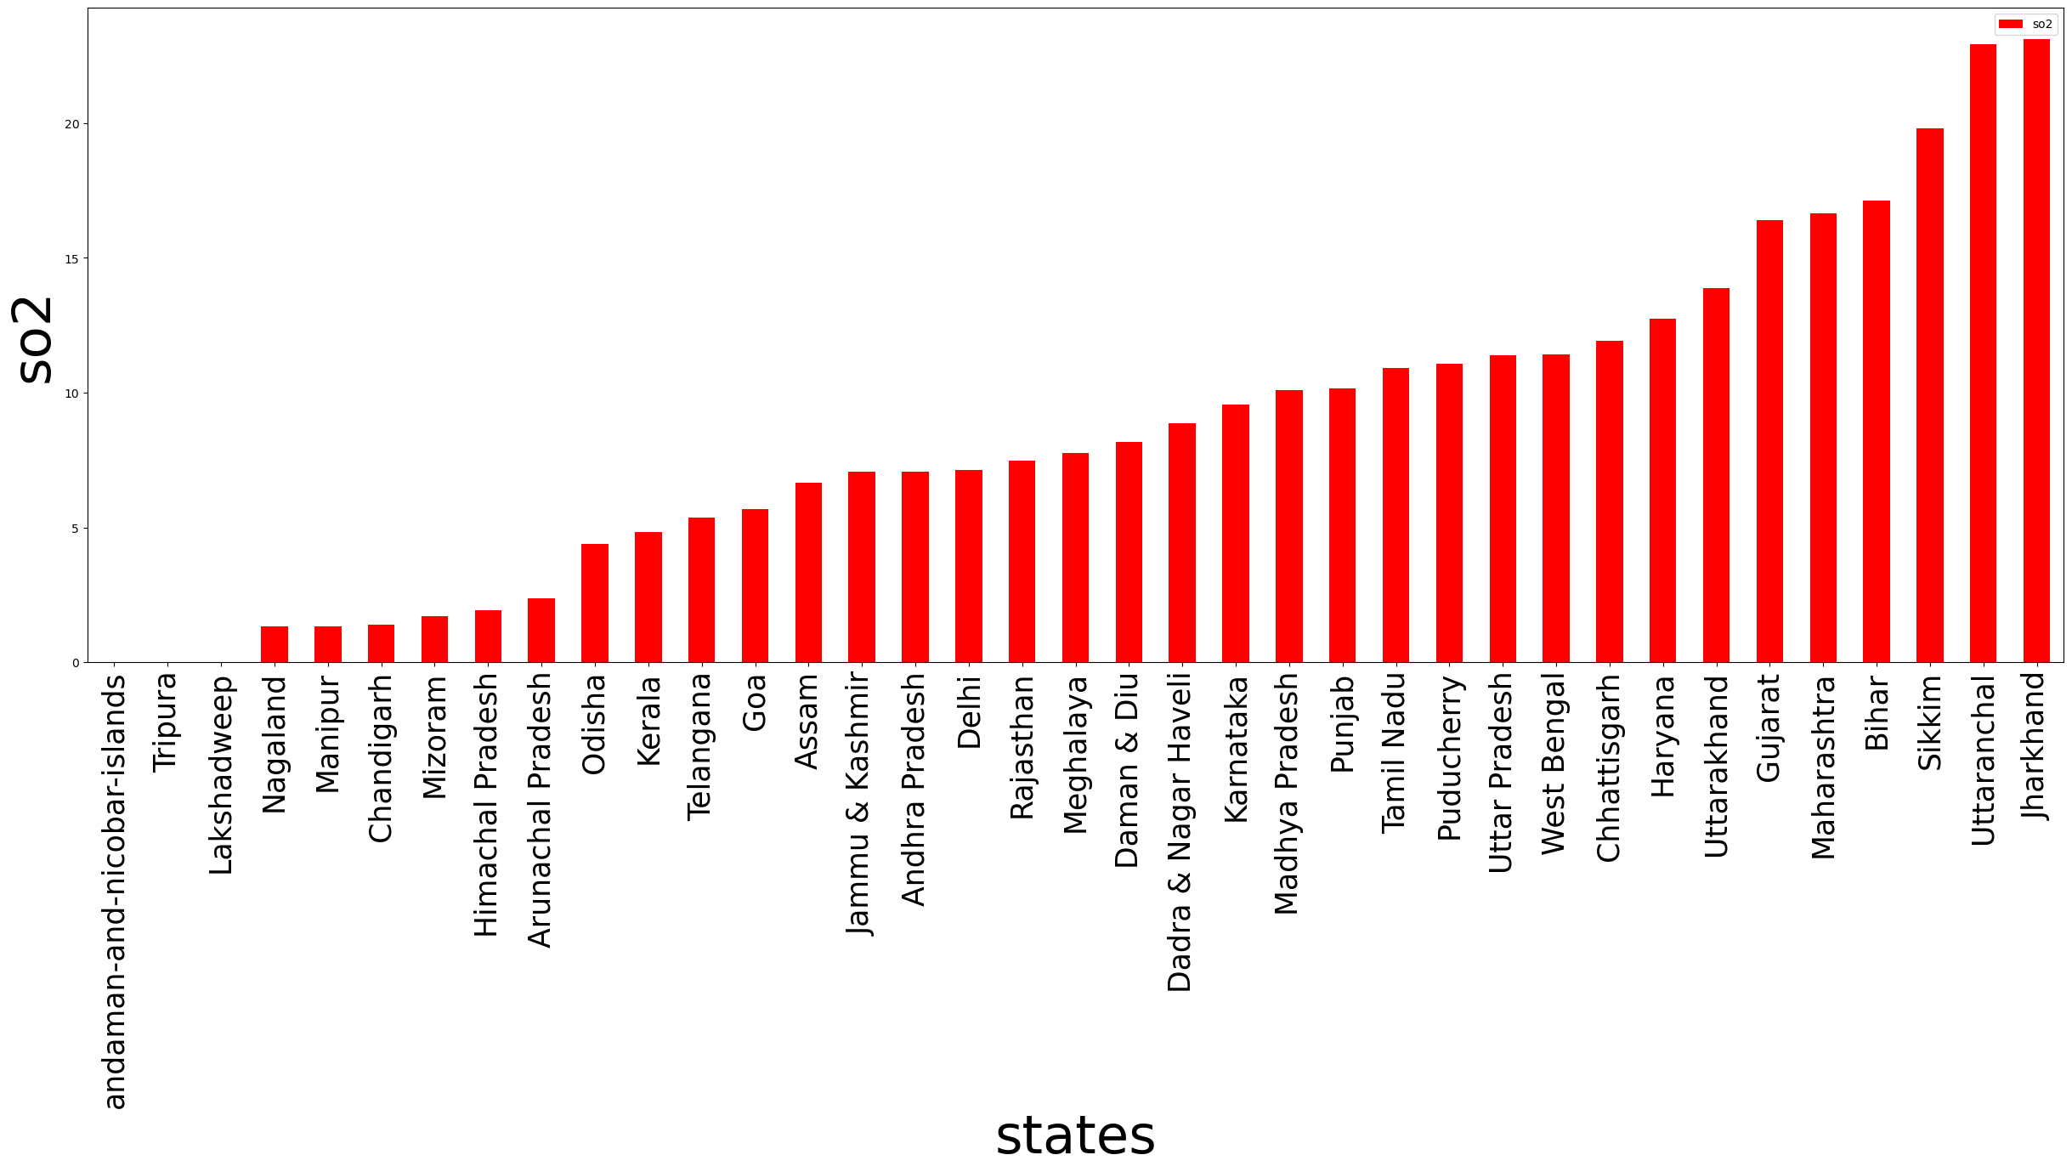

Slide 9
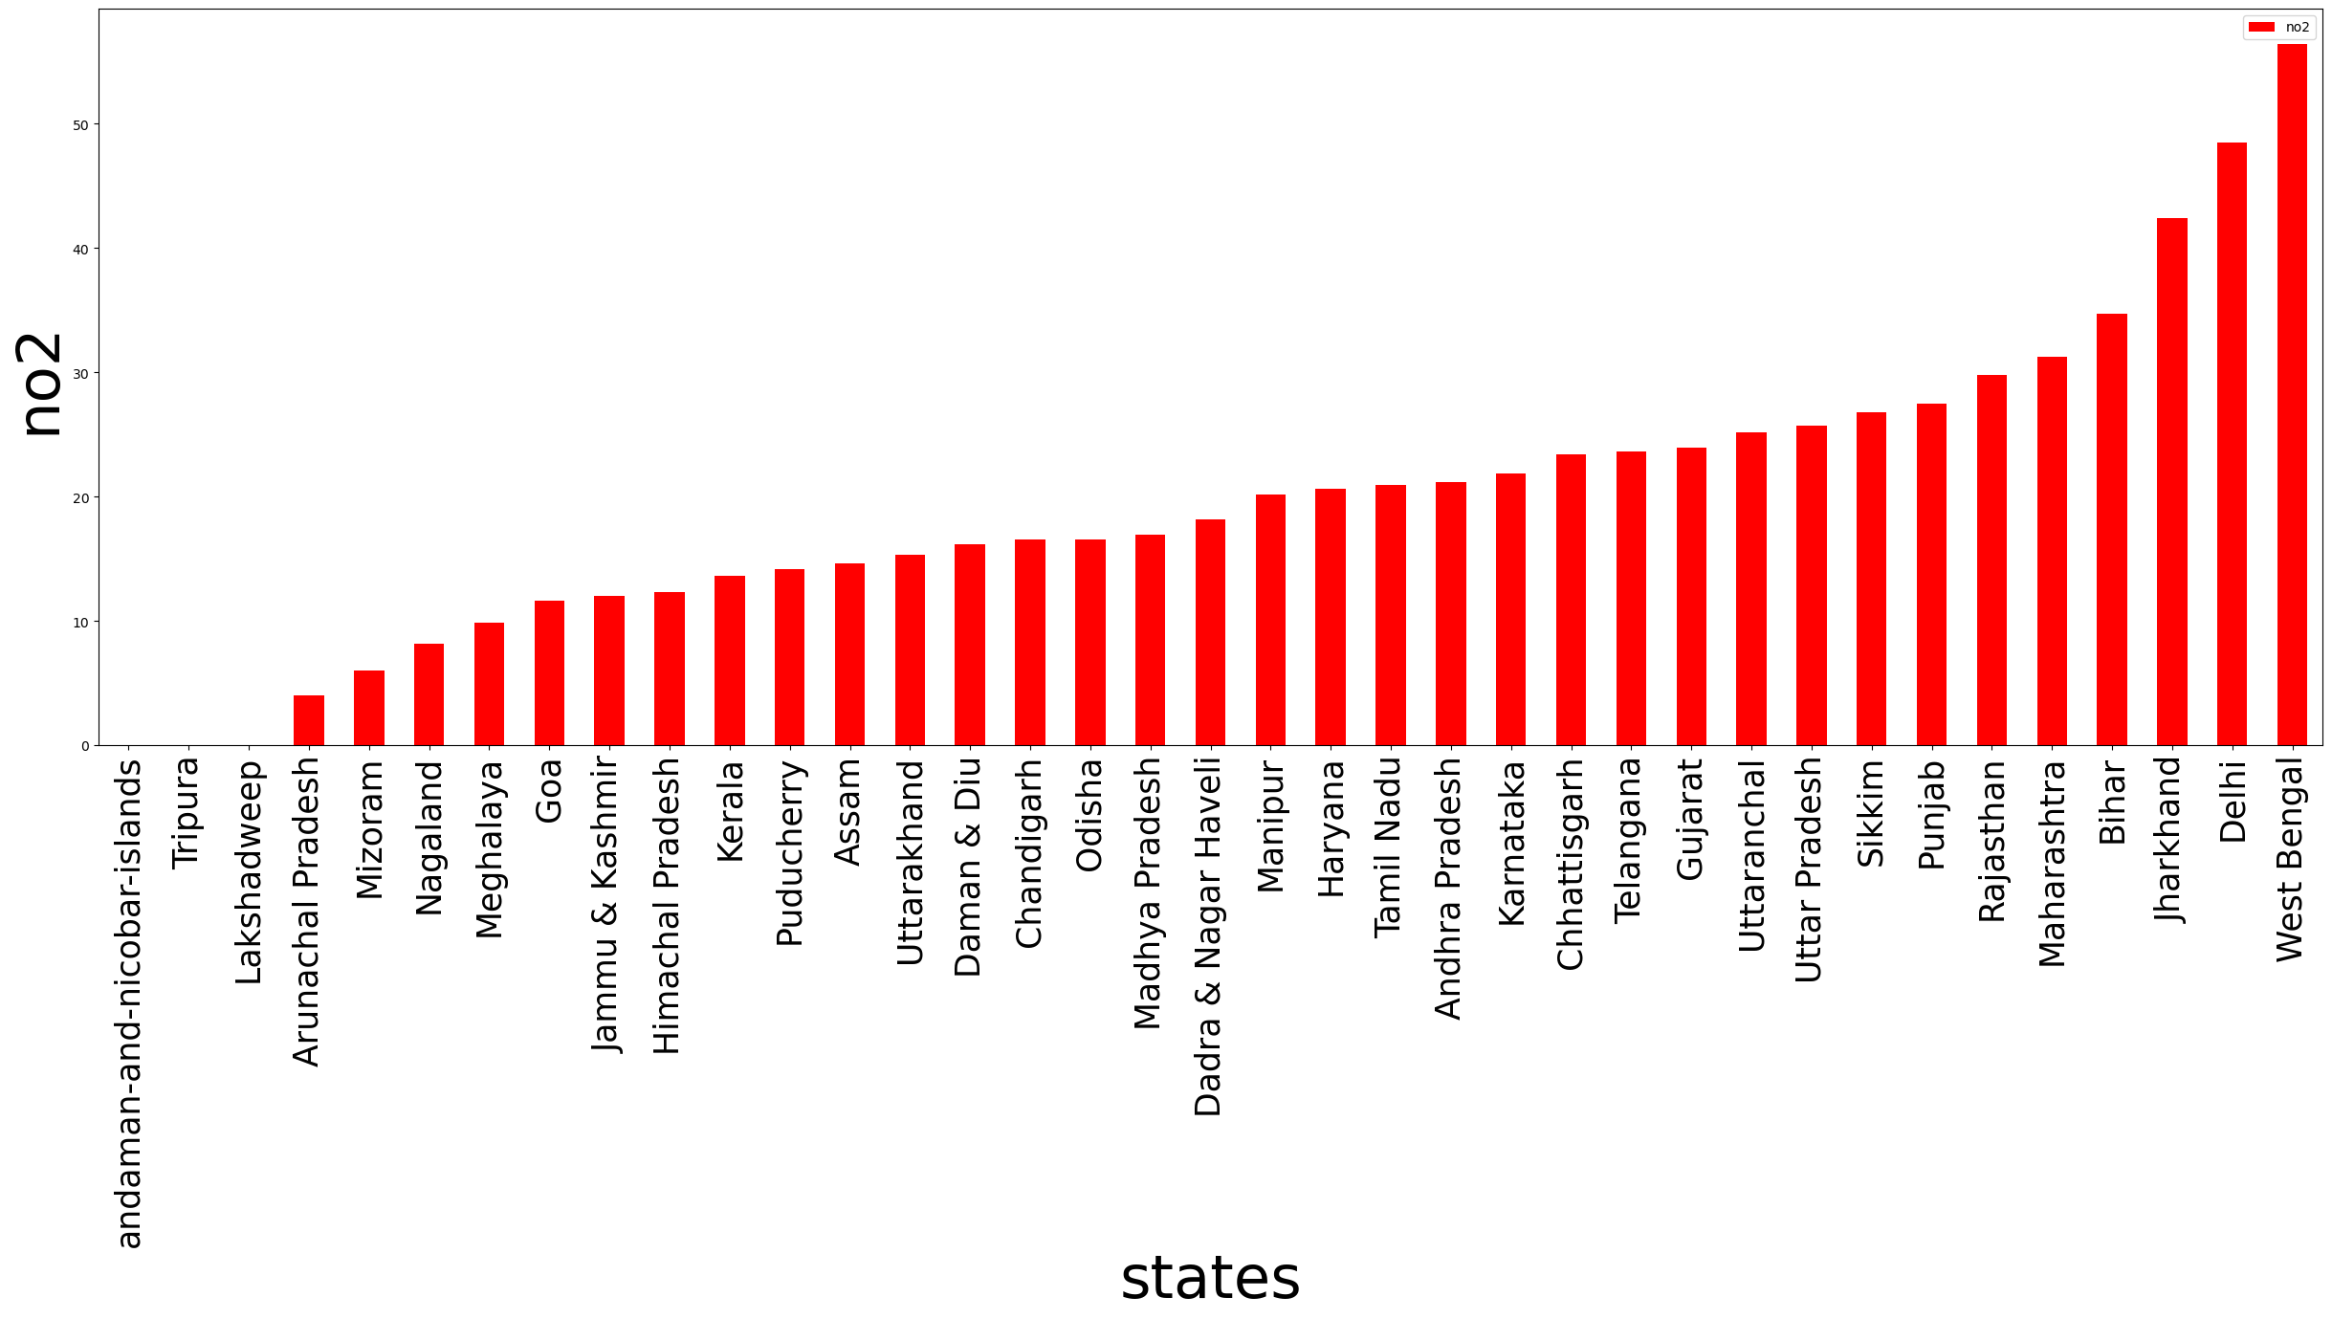

Slide 10
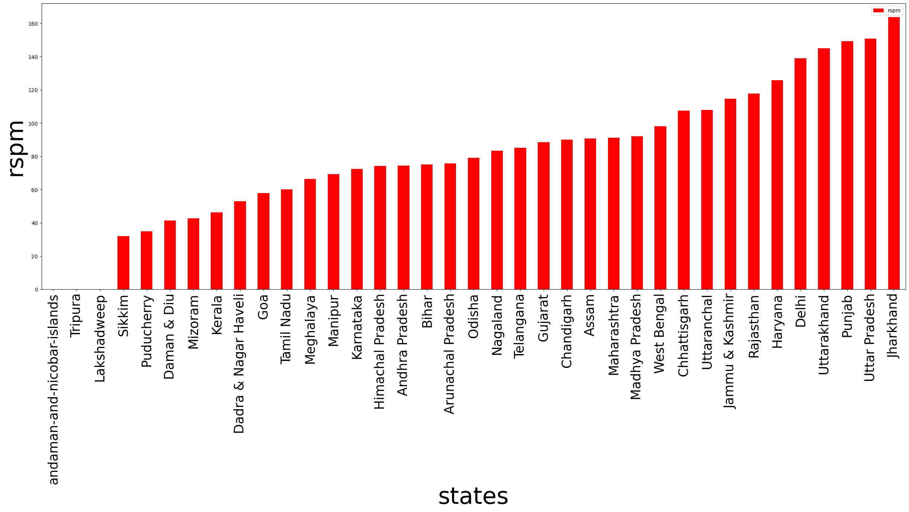

Slide 11
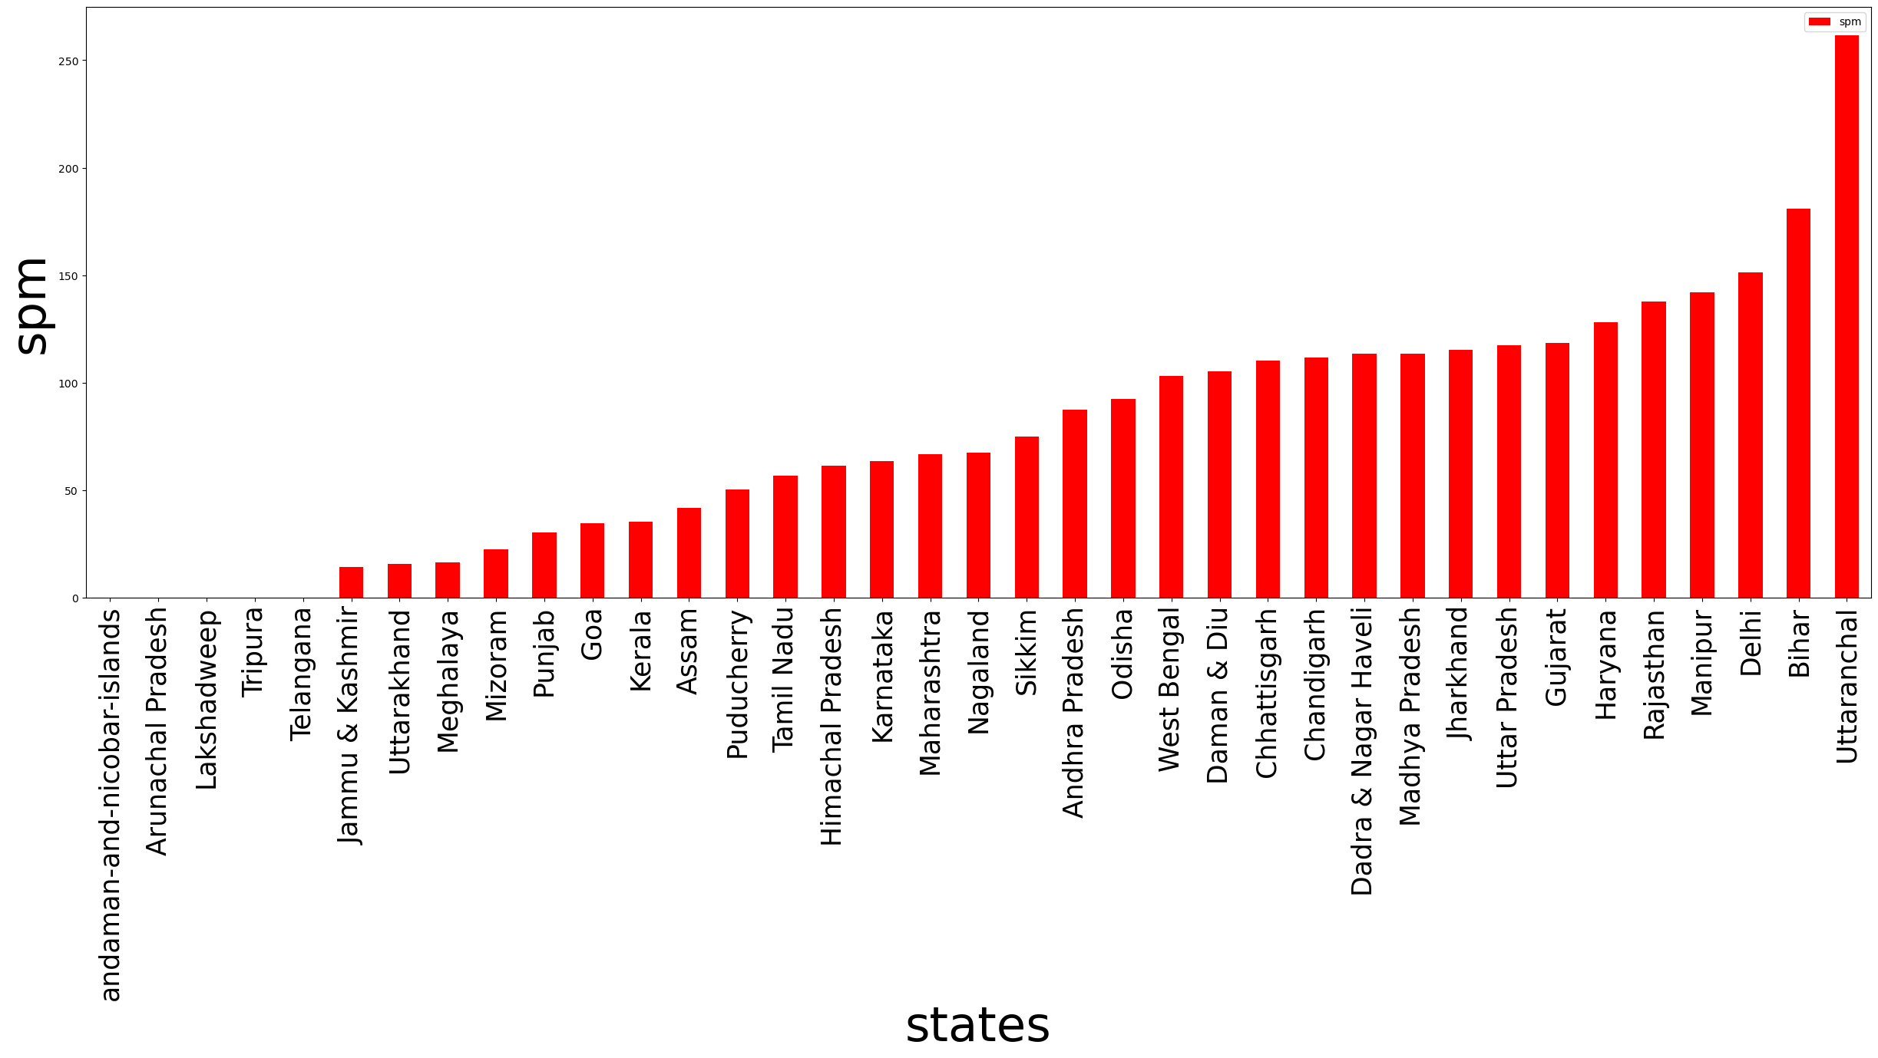

Slide 12
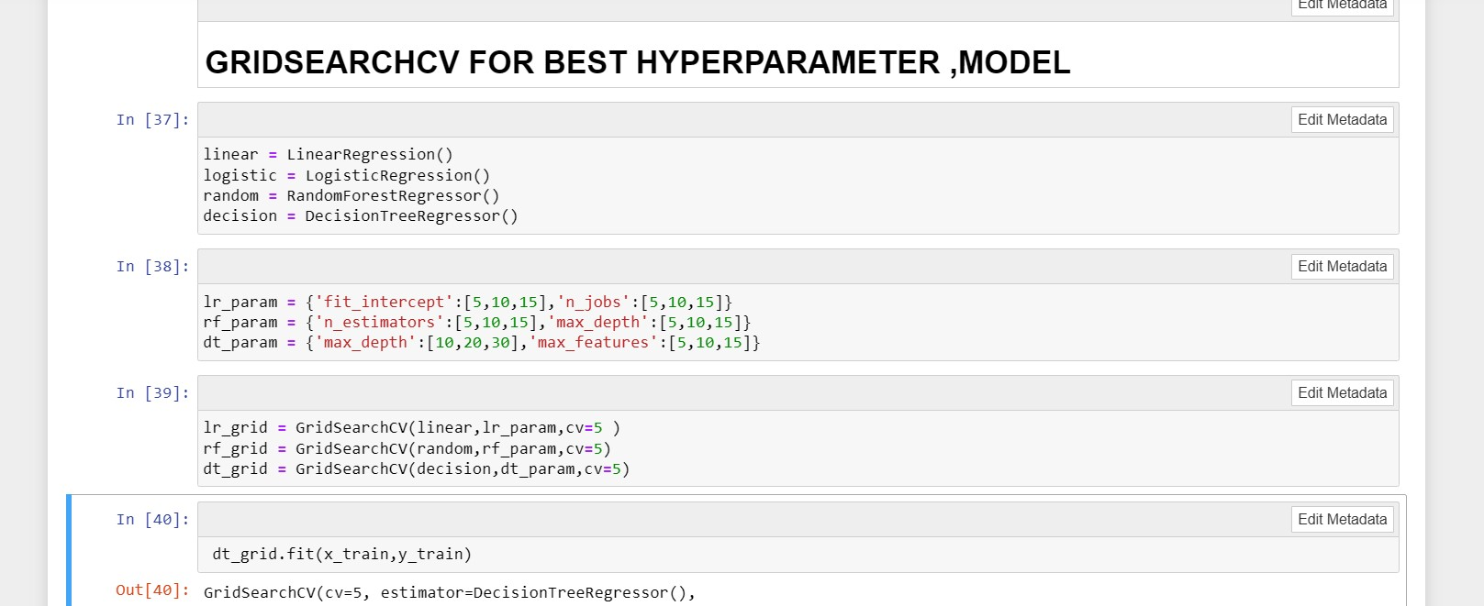
BUILDING MODELS

Slide 13
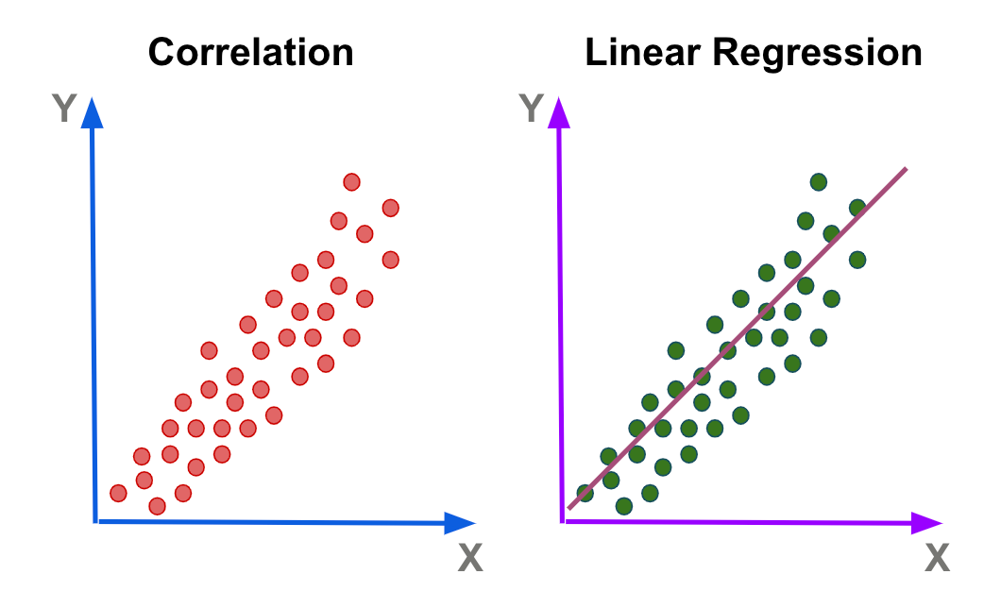

LINEAR REGRESSION
Simplicity and Interpretability: Linear regression models are simple and easy to understand. The relationship between the dependent variable and each independent variable is assumed to be linear, making it straightforward to interpret the coefficients of the model.
Predictive Power: Linear regression can provide reasonably accurate predictions, especially when there is a linear relationship between the independent variables and the dependent variable. It is effective when the underlying data follows a linear trend
DECISION TREE
Interpretability: Decision trees provide a clear and interpretable representation
of the decision-making process. The tree structure allows us to understand the
logic behind the predictions by following thebranches and nodes.

Slide 14

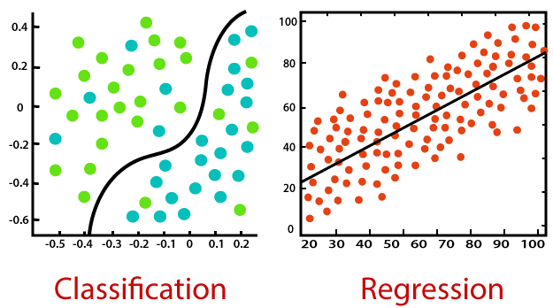
RANDOM FOREST
Robustness: Random Forest Classifier is known for its robustness against overfitting. It combines multiple decision trees, each trained on a different subset of the data with random feature selection. This ensemble approach reduces the risk of overfitting and helps to generalize well to unseen data, which is crucial for accurate AQI prediction.
Handling Nonlinear Relationships: Random Forest Classifier can effectively capture nonlinear relationships between input variables and the target variable. Air quality is influenced by various factors, such as pollutant levels, weather conditions, and geographical factors, which often exhibit complex interactions. Random Forest Classifier's ability to model nonlinear relationships makes it suitable for capturing the intricate patterns in air quality data.

Slide 15
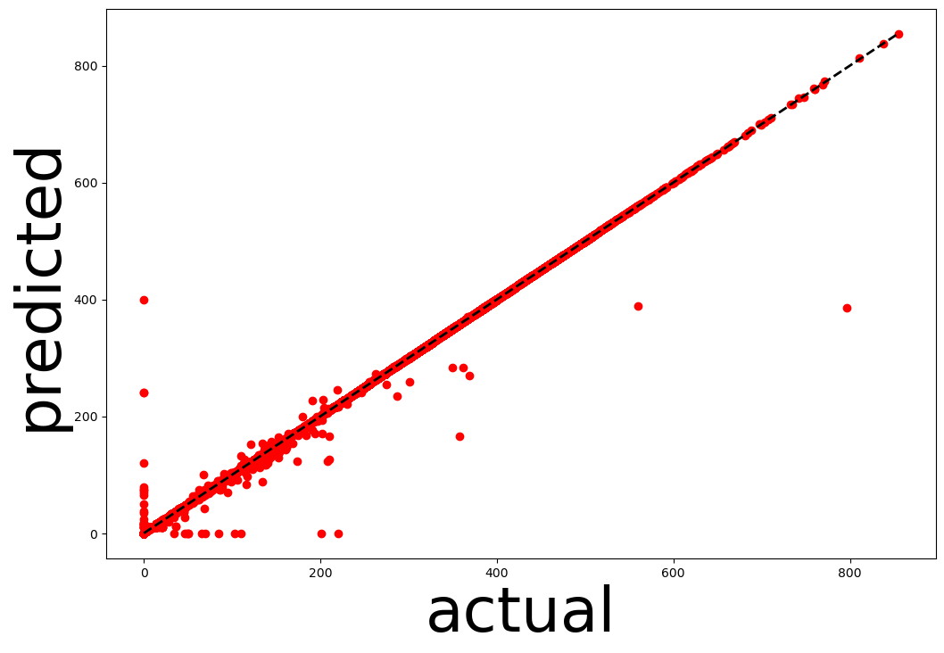

Slide 16
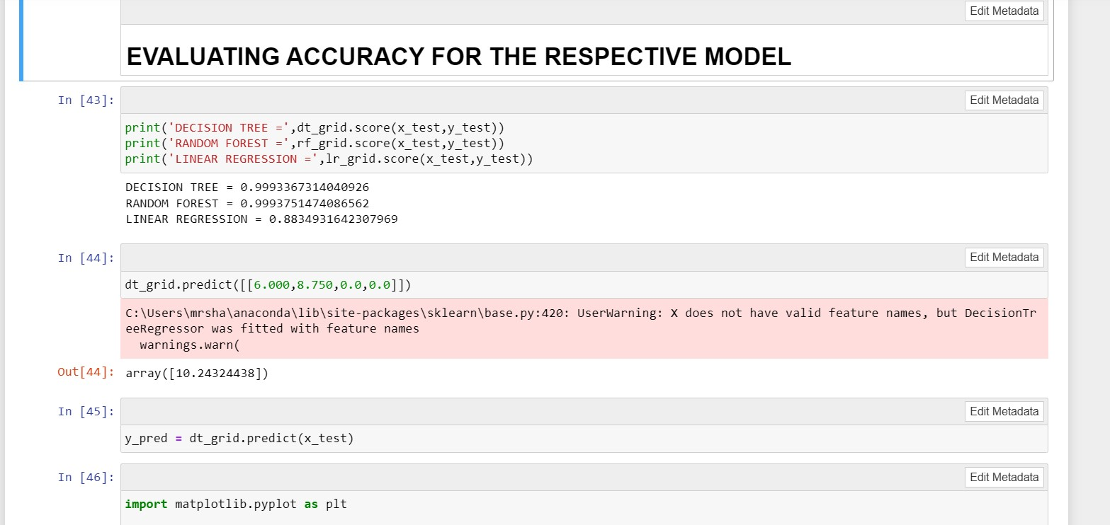
MODEL EVALUVATION AND DEPLOYMENT

Slide 17


Slide 18
ITS BEEN A PLEASURE .THANK YOU

